Slide 1
Individual Project 2 Mobile Game
Thommes Noël

Slide 2
UI

Slide 3
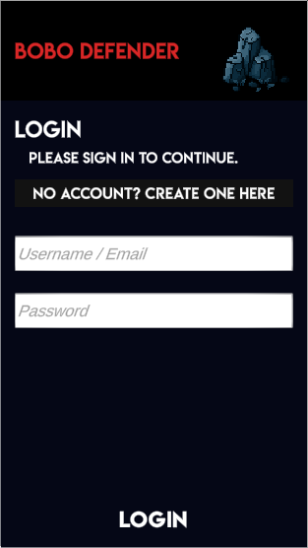
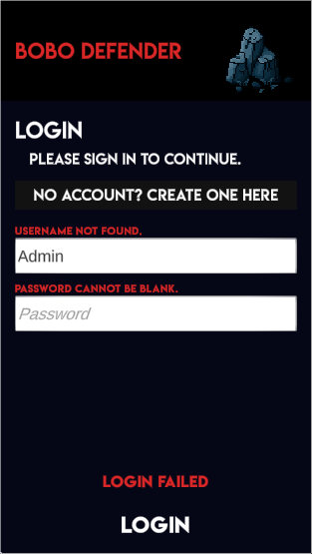
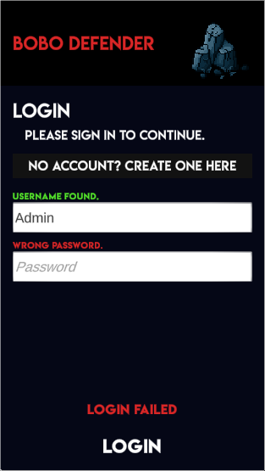
Login

Slide 4



Register

Slide 5
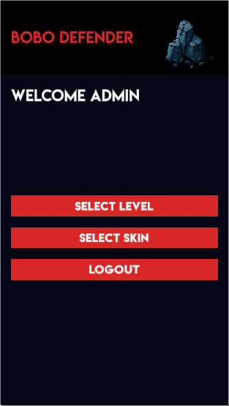
Main Menu

Slide 6
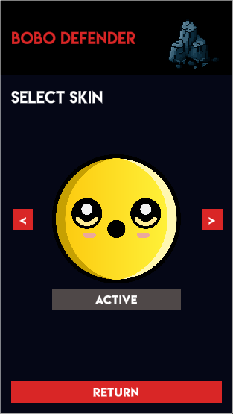
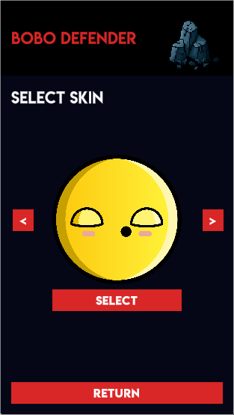
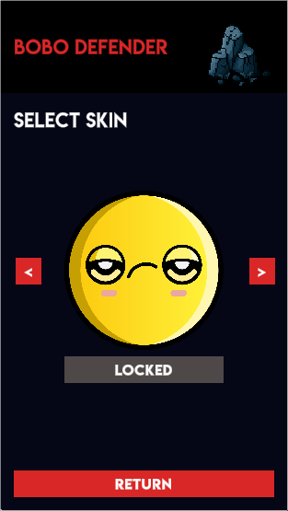
Change skin menu

Slide 7
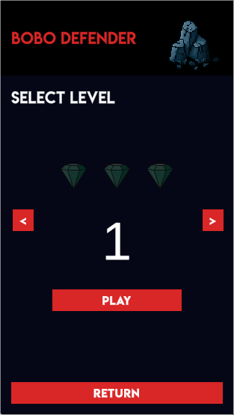
Level Selection Menu

Slide 8
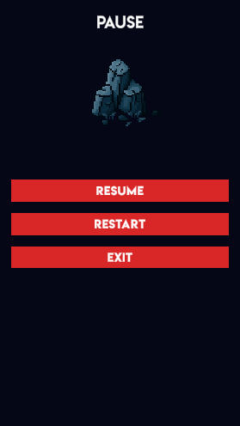
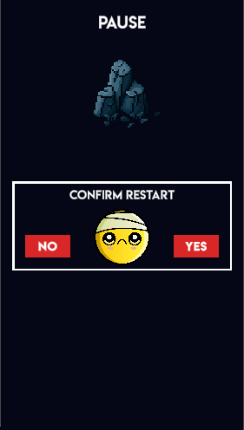
In-Game menu

Slide 9

Game

Slide 10
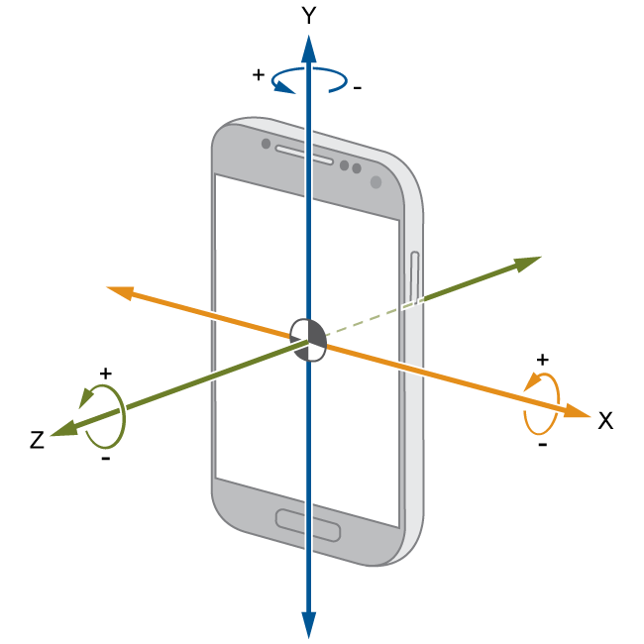
Mechanic: Rotate player
Use the gyro to point the players direction.

Slide 11











Mechanic: Charge Player
Charge the player with the finger pressed on the
screen.

Slide 12

Releasing the charge
Releasing the charge will mark an icon at the player’s position.
Once released, the distance between the origin-position and player-position is calculated every frame and displayed above the player-icon.

Slide 13

Enemies
Enemies look like this:
The green number determines the required distance amount to kill the enemy.
Red number is the amount of damage the enemy infringes on the crystal if the player fails to kill it before it reaches its path to the crystal.
They are frequently spawned at different intervals and different amounts.

Slide 14
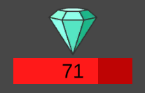
Crystal
There are always three crystals in a level. The player must protect them. If one crystal is fully destroyed the level score is reduced by one.
If all three crystals are destroyed, the game is lost.
Enemies are destroyed on contact with the crystal after reducing its health.

Slide 15
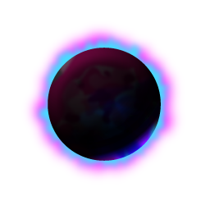
Blackhole
The blackhole rotates clockwise around the center with an offset of 10 units.
Each turn takes 5 seconds to complete.

Slide 16

Portal
The circle rotates also round the center and is positioned in the opposite direction of the black hole.
The portal teleports the player in a random direction within the map if it collides with it.

Slide 17

Spawning obstacles
There are 8 falling spots in the map.
Every 7 seconds it has a change of 40% to spawn an obstacle falling from top to bottom pushing the player down when colliding.
The obstacle is destroyed when arriving at the bottom.

Slide 18
Audio
There is audio when the player:
collides with the boundaries of the world.
kills an enemy.
crystal is being attacked.
charging the power.
releasing the power.

Slide 19
plot
The dwarfs has asked the smileys to protect their treasures against greedy robbers.
They are squeezy and bouncy, ideal for maneuvering high speed movements in complex areas.

